Slide 1
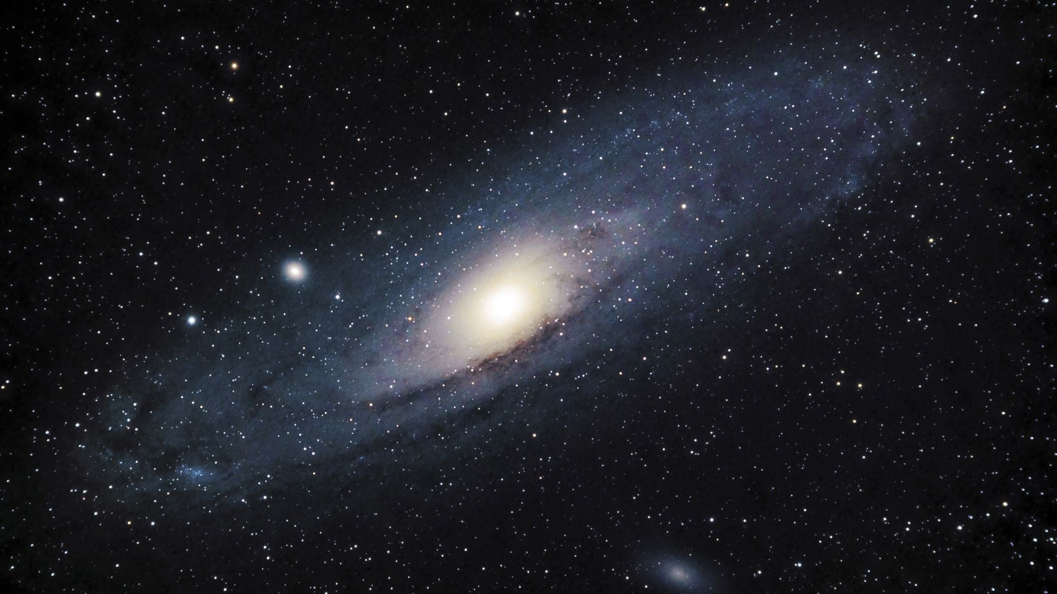

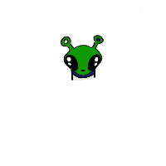
Salus Challenge Gleeby's Galaxy
Space Cadets
Christina Butuc, Alex Butuc, Luke Smith

Slide 2


Why?

Slide 3
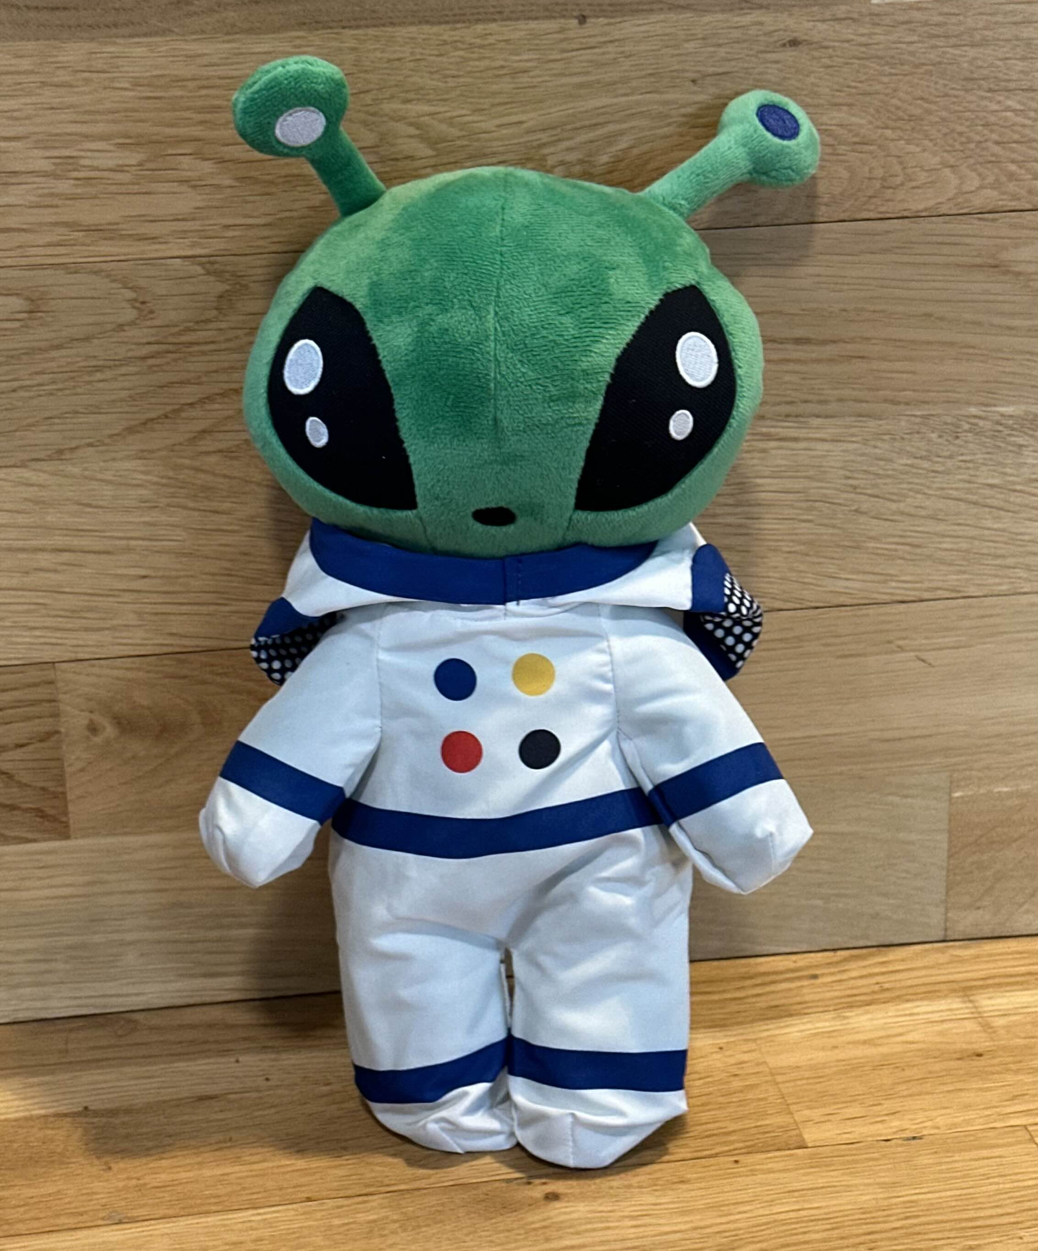
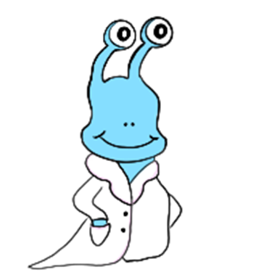
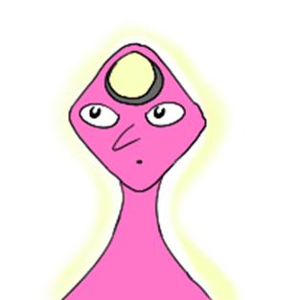

What we made
You!

Slide 4

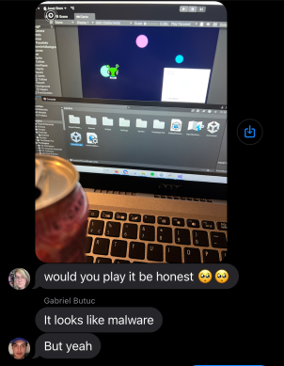


What we made
- 2D game using Unity and Github
JUST KIDDING!! It broke
- Text-based adventure in Twine!!

Slide 5
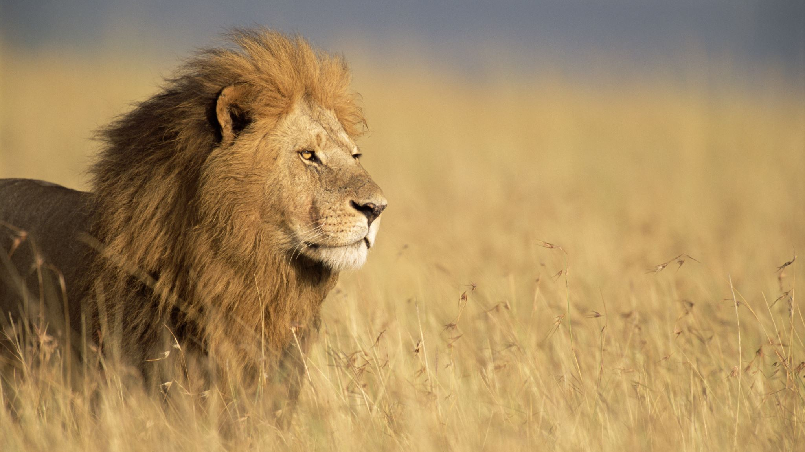
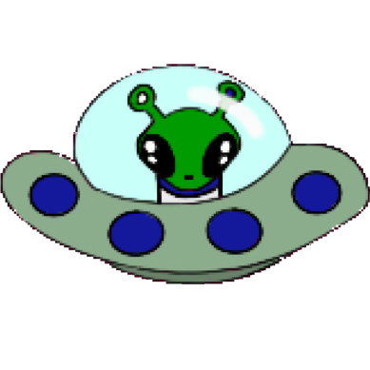
Resilience.

